Slide 1
When do we call neurons are firing in burst?
Joint Lab Meeting
Selva Maran

Slide 2
One definition of a burst
1) physiologically relevant
2) transient
3) increase in firing rate
4) above the background activity
(Lobb 2013)

Slide 3
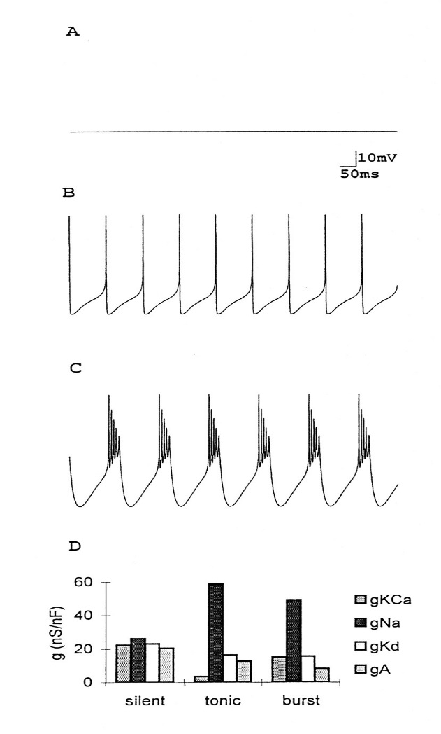
Neuron in Different firing mode
– silent, tonic and bursting
Marder E et al. PNAS 1996;93:13481-13486
©1996 by National Academy of Sciences
Notes:
Different patterns of activity in a model neuron. Computer simulations using a model modified from that in ref. 12. (A) Silent neuron. (B) Tonic activity. (C) Oscillatory activity. (D) Plots of four of the seven currents in the model showing the relative balance of conductances giving rise to the patterns of activity shown in A, B, and C (Z.L., unpublished data). Taken from ref. 12.
Neurons can display a variety of activity patterns that depend on the number and type of voltage channels in their membranes (Fig. 1). Some neurons are silent unless excited; others are spontaneously active. Some neurons display intrinsic oscillatory properties involving periodic bursts of action potentials

Slide 4

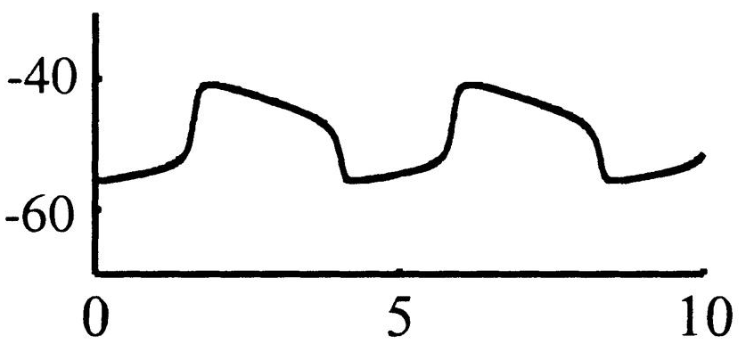
Bursting from the point of a typical central pattern generator
Canavier et al., 1999
Bursting is due to periodic shift in membrane potential between suprathrehold and subthreshold levels for action potential generation.
Most often Slow channels play important role in generating the slow membrane potential oscillation
In many cases change from one mode to other mode is more steep

Slide 5
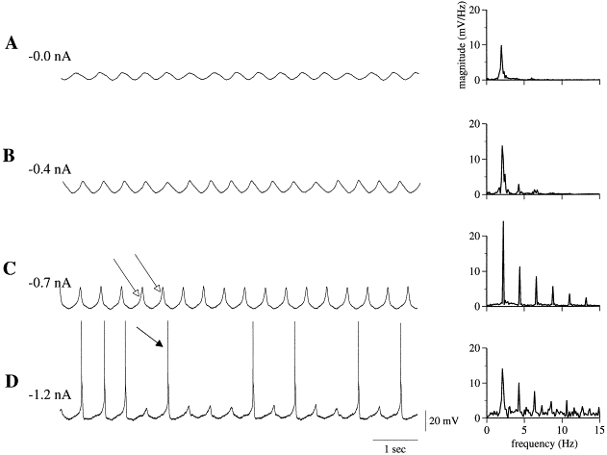
Single spikes riding on membrane potential Oscillation
Lampl, Yarom 1997

Slide 6
Do we call the burst in CPGs as burst or oscillation ?

Slide 7
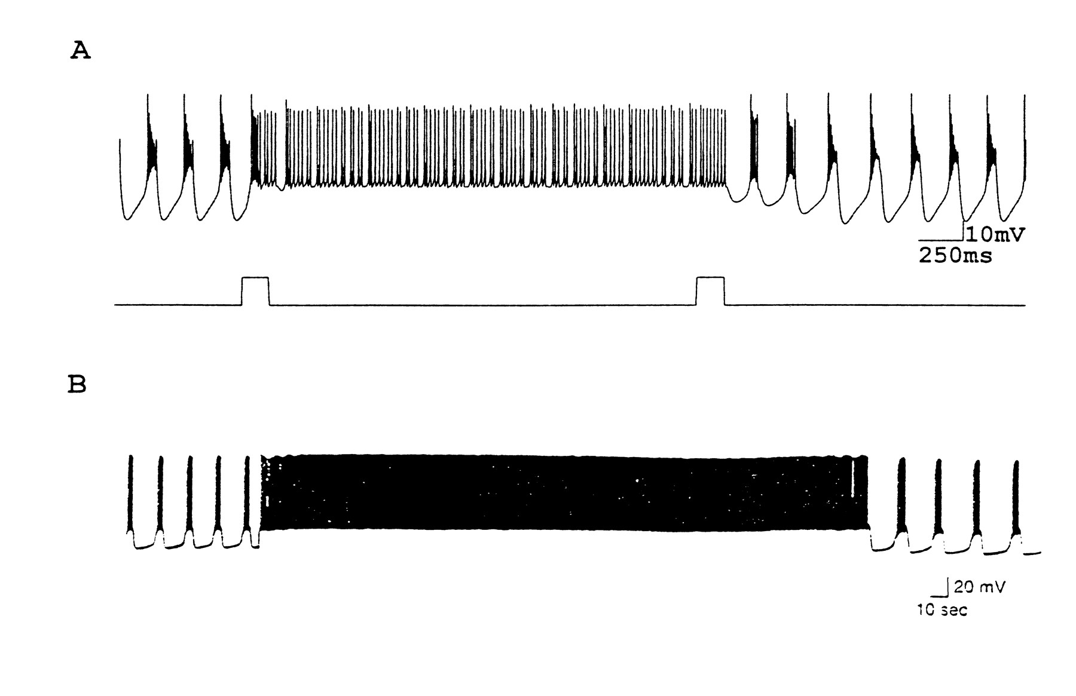
Mode switches between tonic firing and bursting.
Marder E et al. PNAS 1996;93:13481-13486
©1996 by National Academy of Sciences
Notes:
Mode switches between tonic firing and oscillatory action. (A) Model neuron initially in a bursting mode. A short depolarization flips the model into the tonic firing mode, where it remains until a second perturbing pulse, which switches it back into the bursting model (Z.L., unpublished data). (B) Intracellular recording from R15 in Aplysia. The neuron was initially in the bursting mode but was switched into the tonic firing mode by a short depolarizing current pulse (modified from ref. 18).

Slide 8
Irregular switching between tonic mode and burst mode in thalamus
Red belongs to burst mode. Black belongs to tonic mode.
Sherman 2001, TINS

Slide 9
Bursting from view of measuring spiking regularity
Gamma distribution
κ - Shape or order parameter
β – rate parameter
Shinomoto et al.,2003, 2009

Slide 10
1) physiologically relevant
2) transient
3) increase in firing rate
4) above the background activity
(Lobb 2013)
If a neuron bursts regularly – a neuron in the stomatogastric ganglion, for example – then this definition would say that there are no “bursts”
Does Bursting have to be transient increase in firing rate above the background activity
How do we measure or quantify Bursting ?

Slide 11
Does bursting have 1) any role 2) unique role in coding behavior in higher brain regions?
Bursting in thalamus are more often considered to happen during behaviorally irrelevant state – drowsiness, sleep and diseases
Arthur Sherman work – does have a unique role that is different from tonic mode
Tonic mode – linear coding
Bursting mode – Wake up call, coding surprise event, nonlinear coding
Dopaminergic neuron
Tonic activity - vigilance
Phasic or bursting activity – reward predicting events
Does bursting should always be due to a unique physiological mechanism ?

Slide 12
Summary
Do we call the burst in CPGs as burst or oscillation ?
Does Bursting have to be transient increase in firing rate above the background activity
How do we measure or quantify Bursting ?
Does bursting have 1) any role or 2) unique role in coding behavior in higher brain regions?
Does bursting should always be due to a unique physiological mechanism ?

